Slide 1
Adam Yuan
Sean Xu
Terry Wu
SR-5 Solutions

Slide 2
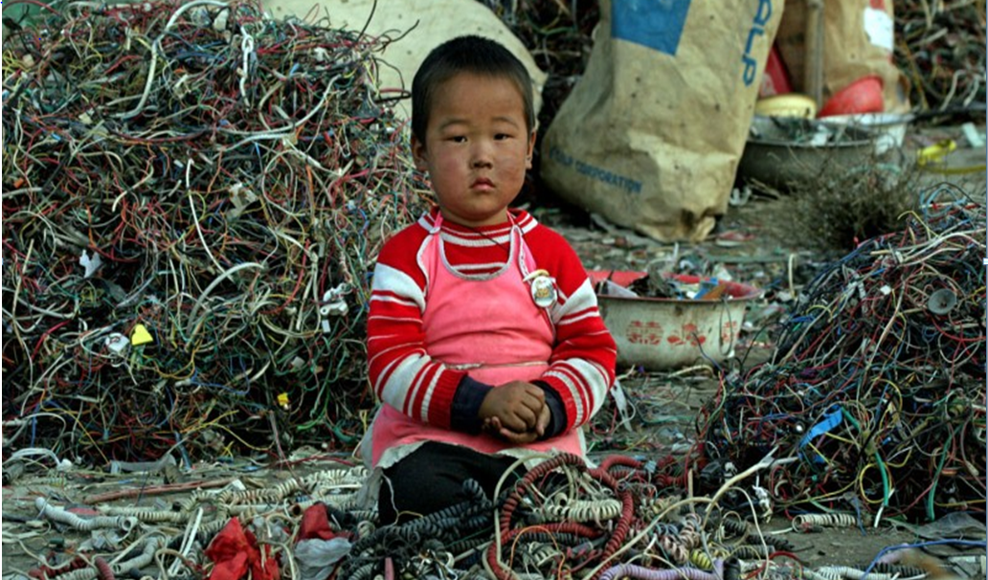

Slide 3
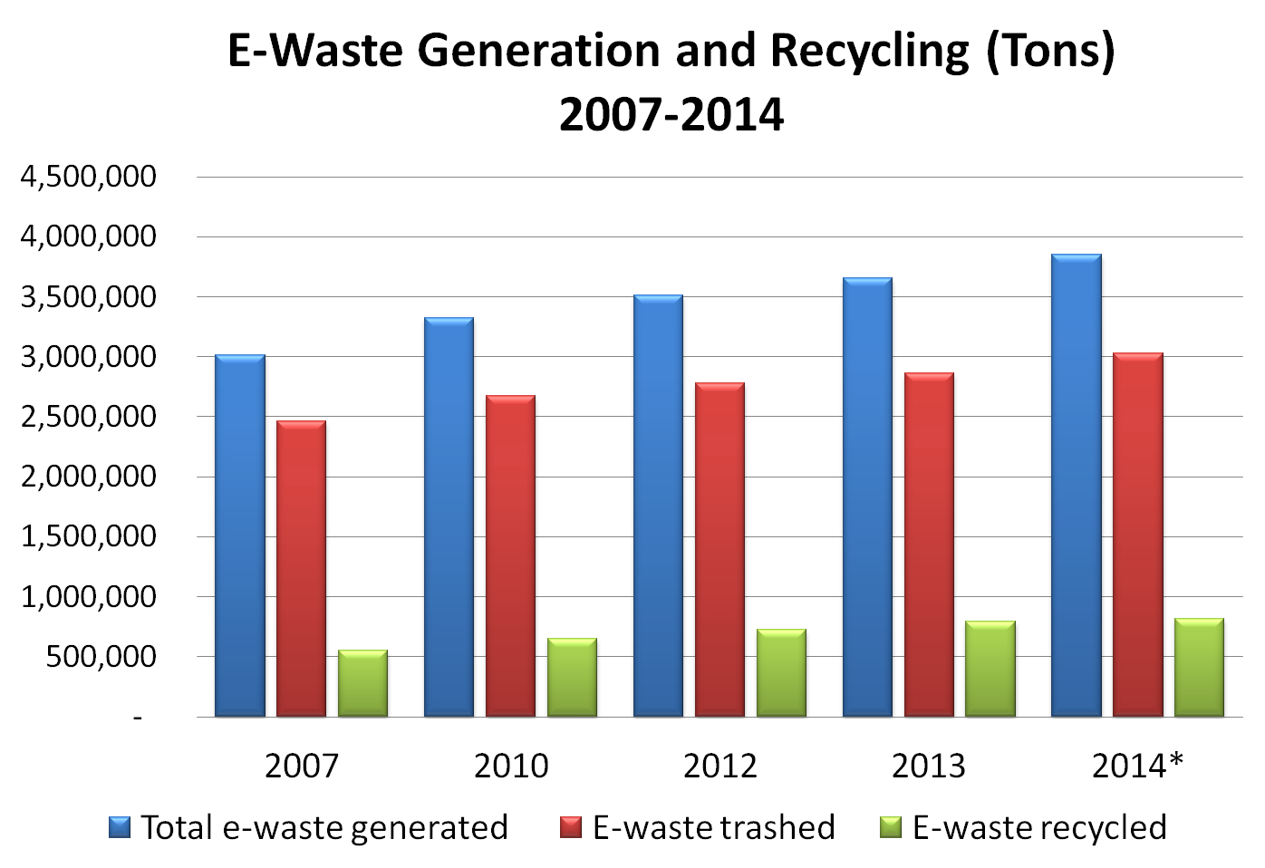
Source: http://www.electronicstakeback.com/category/blog

Slide 4
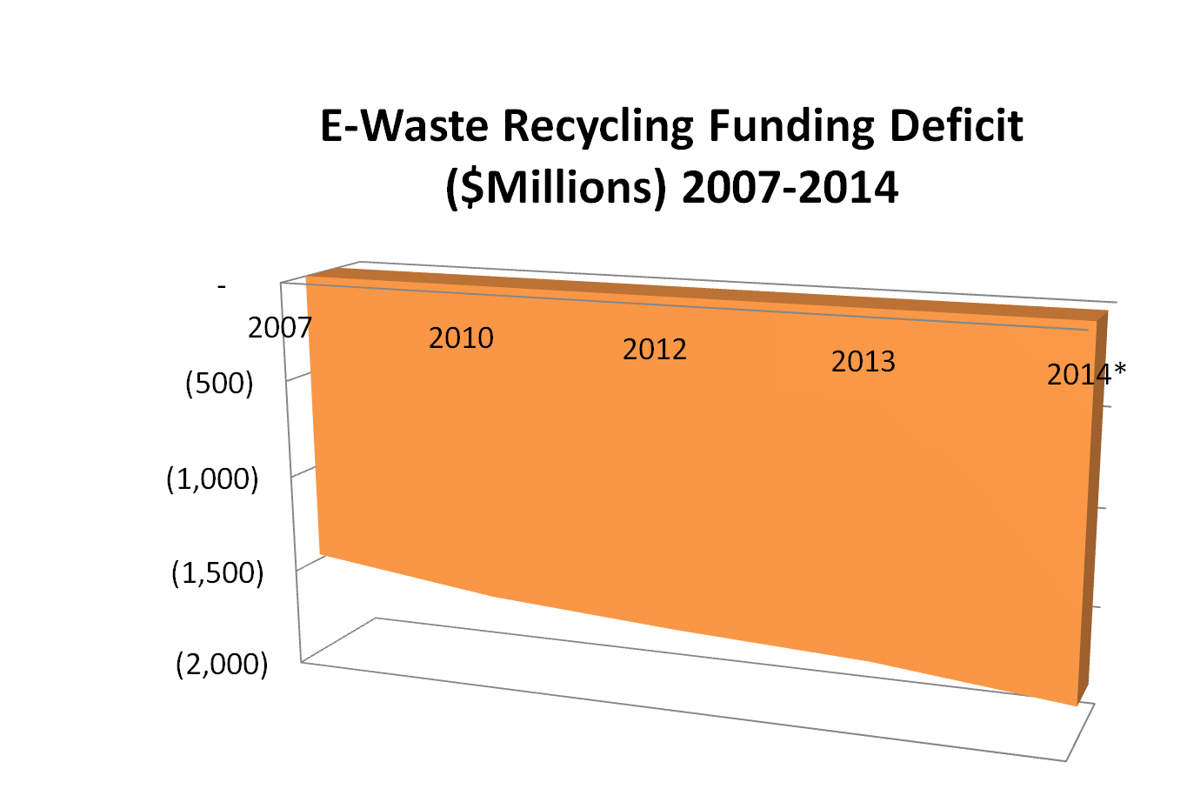
Source: http://www.electronicstakeback.com/category/blog

Slide 5
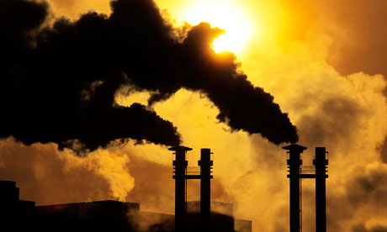
Social Issues

Slide 6
Self Sustaining Social Enterprise Incubator
Capital invested in
SR-5 Solutions
Foreign investors
Repayment and returns can be re-invested
Positive social impact

Slide 7
Social Responsibility-5 Visa

Slide 8
SR-5 investors
$ 1 million
10 years
SR-5 Solutions
SR-5 Social Enterprise Incubator
SR-5 Social Impact Fund

Slide 9
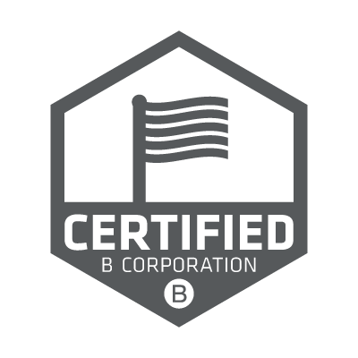
Benefit Corporation (B Corp.)
Corp.
A type of for-profit entity in some U.S. states that wishes to consider society/environment in addition to chasing profit. It differs from traditional corporations in its purpose, accountability, and transparency.
-- Wikipedia.org
Corp.
Corp.
Corp.

Slide 11
Financial Service
Networking
SR-5 Social Enterprise Incubator
Business Training
B Corp. Verification Service
Contract Management
Supply Chain Network

Slide 12
B Corp. Verification Service
Strong social impact
Financial capacity
Scalability
Best-practice

Slide 13
Fund Management
SR-5 investors
Capital Return
Capital contribution
Management of fund
SR-5 Social Impact Fund
Management fee
Benefit Corp. 1
Benefit Corp. 2
Benefit Corp. 3

Slide 14
From Idea to Reality
SOCIAL IMPACT FUND INVESTMENT
GROWTH SUPPORT
FINANCIAL SUPPORT
Seed Phase
Start-Up Phase
Extension Phase
Late Stage Phase
SR-5 Social Enterprise Incubator
SR-5 Social Impact Fund

Slide 15
True Stories

Slide 16
Benefits
Capital in flow
More jobs
Link resources

Slide 17
SR-5 Solutions
Thank you

